Slide 1

VIDEO GAME SALES
SANI THOMAS

Slide 2
TABLE OF CONTENTS
Regional Sales Trend
Root Causes of Europe Raise
Root Causes of N.America Drop
Top Genres per Region
Top Platforms per Region
Top Publishers per Region
Cross Dimensional Marketing Sales Lead
Approaches to Boost Sales Across Different Regions

Slide 3
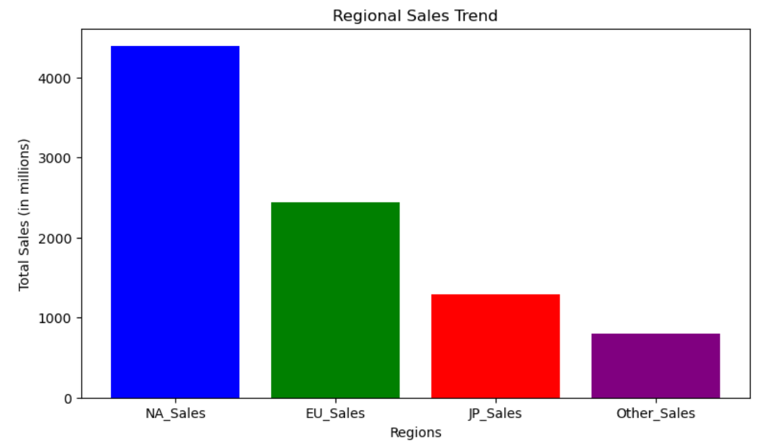
REGIONAL SALES TREND
North America (NA_Sales): Highest sales, over 4000 million units.
Europe (EU_Sales): Second-highest sales, just above 3000 million units.
Japan (JP_Sales): Third-largest market, around 1500 million units in sales.
Other Regions (Other_Sales): Lowest sales, approximately 1000 million units.

Slide 4
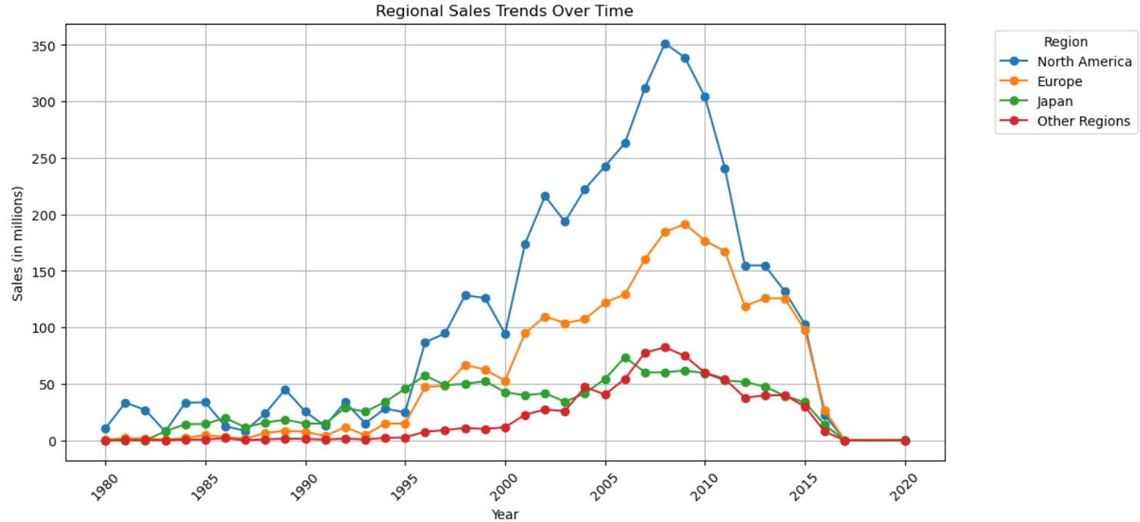
Regional Sales Trends Over Time
North America: Peaked around 2005 (~350 million units), then sharply declined by 2020.
Europe: Sales peaked around 2008 (~200 million units) and gradually declined to near zero by 2020.
Japan: Stable sales with a peak in 1995, then a gradual decline, stabilizing before decreasing further by 2020.
Other Regions: Consistently lower sales, peaking around 2008 (~50 million units), then declining to near zero by 2020.

Slide 5
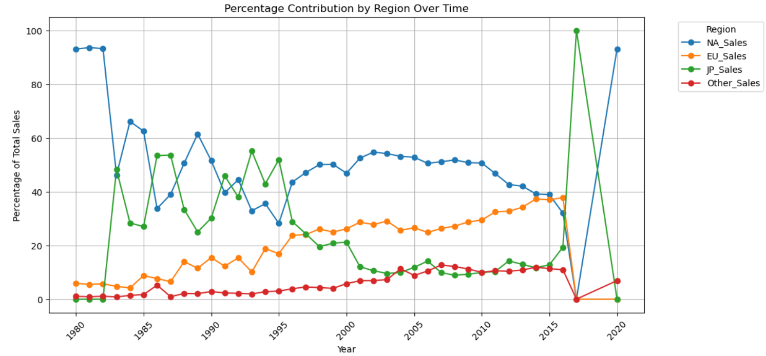
Percentage Contribution by Region Over Time
NA Sales: Dominated market until around 2010
EU Sales: Consistently rose, stabilizing post-1990
JP Sales: Experienced fluctuations, declining after 2000
Post-2010 Trends: Marked by significant volatility and market shifts

Slide 6
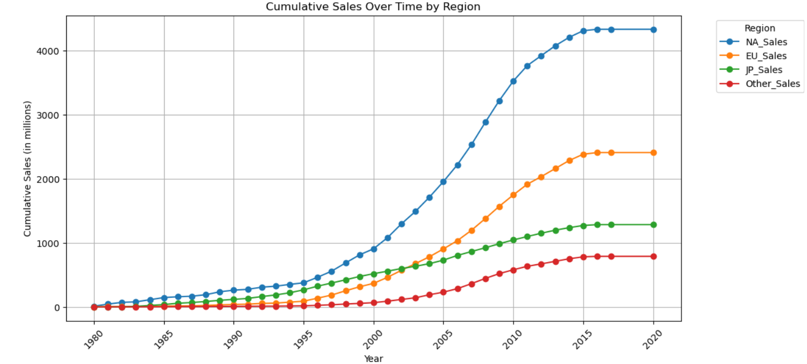
Cumulative Sales Over Time by Region
North America Leads: NA sales have consistently led, surpassing 4000 million.
Europe Rises: EU sales grew steadily, reaching close to 2000 million.
Japan Slows: JP sales grew gradually but leveled off around 1000 million.
Other Regions: Sales in other regions grew slowly, staying under 1000 million.
Post-2000 Boom: All regions saw a sharp increase in sales after 2000, with NA and EU seeing the biggest jumps.

Slide 7
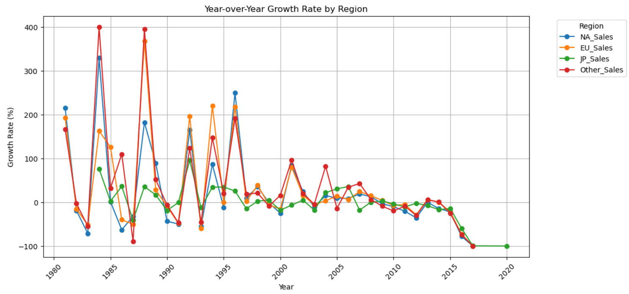
Year-over-Year Growth Rate by Region
1980s-1990s Volatility: NA and EU peaked at 400%, dips to -100% across regions.
Post-2000 Stability: Growth rates steadied around 0-50% across all regions.
2010s Decline: NA, EU, JP, and Others saw drops, some near -50%.
Early Peaks: NA and EU hit 400% growth in mid-1980s.
2020 Convergence: Growth rates across all regions near 0%

Slide 8
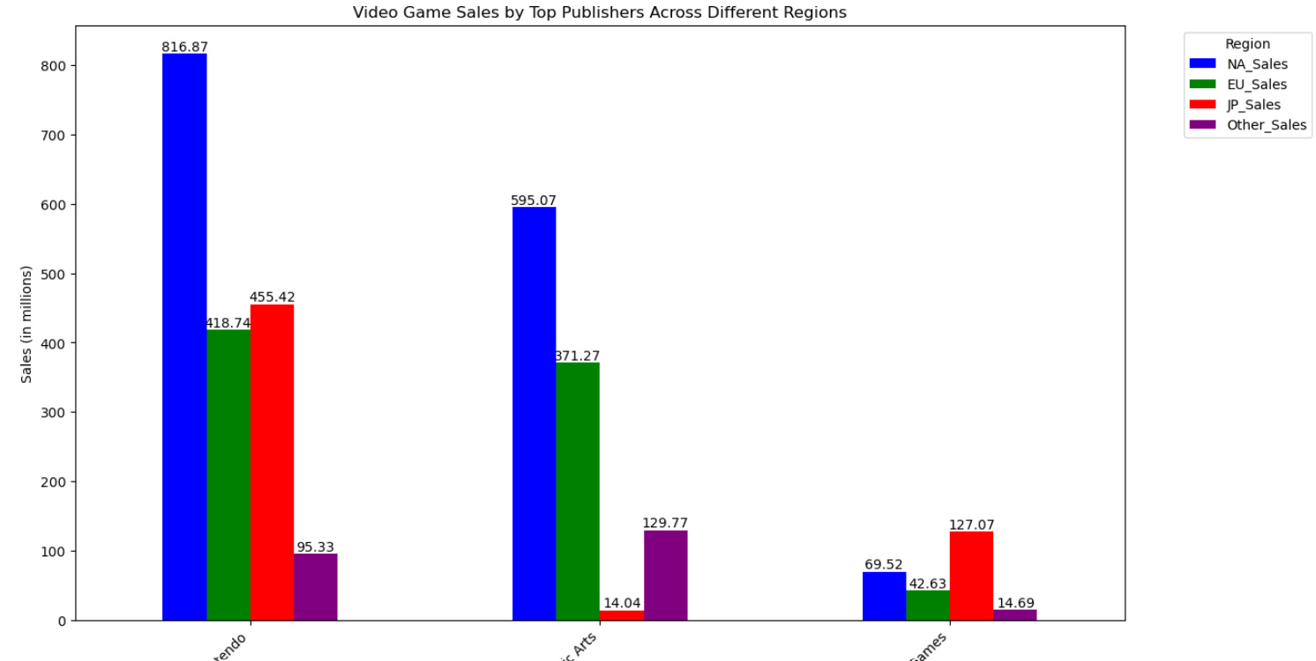
Video Game Sales by Top Publishers Across Different Regions
Nintendo Dominates:
Highest sales in North America (817M) and Japan (455M).
Strong performance in Europe (419M).
Electronic Arts:
Leading in North America (595M) and Europe (371M).
Minimal sales in Japan.
Other Publishers:
Varying success across different regions.
Lower sales in Japan and other regions.

Slide 9
Findings
North America is still the top seller with 6,000 million in sales, but its influence is decreasing.
Europe is catching up fast, now with 5,500 million in sales, growing its share from 25% to 40%.
Japan's role is shrinking, now down to just 10% of the market, while Other Regions are growing stronger, doubling their share to 15%.
Nintendo and EA remain the big players, with Nintendo leading in Japan and North America, and EA ruling in Europe.

Slide 10
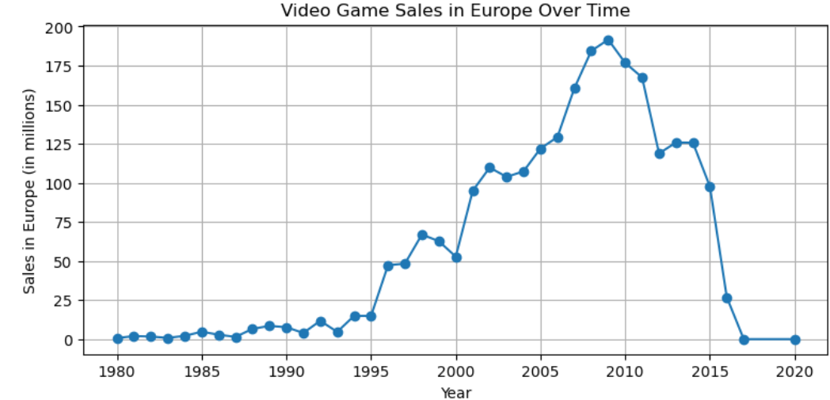
Q2. ROOT CAUSE OF EUROPE RAISE
Video Game Sales in Europe Over Time
Steady Growth (1980-2000): Sales in Europe increased gradually, reaching around 50 million by 2000.
Sharp Rise (2000-2010): Sales surged, peaking at approximately 190 million in 2010.
Rapid Decline (2010-2020): Sales dropped sharply after 2010, falling to almost 0 by 2020.
Peak Sales: The highest point was nearly 190 million in 2010.

Slide 11
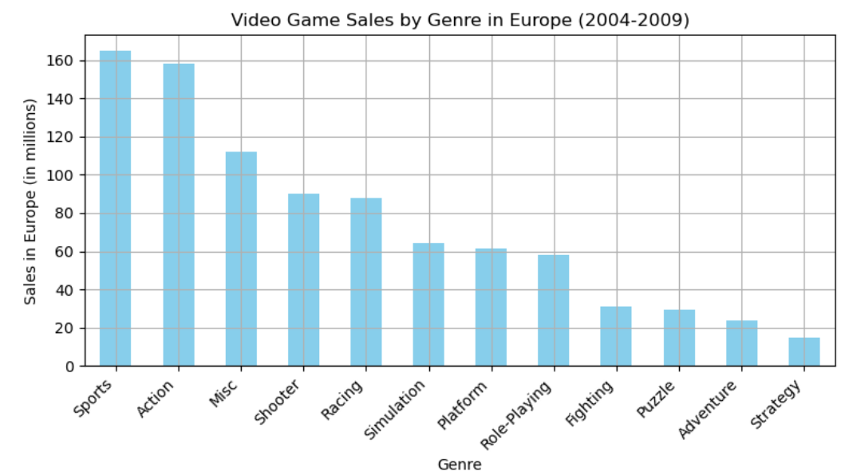
Video Game Sales by Genre in Europe (2004-2009)
Top Genres: Sports (160M) and Action (150M) are the leading genres.
Middle Tier: Misc (120M), Shooter (100M), and Racing (90M) follow.
Lower Sales: Simulation (80M), Platform (70M), and Role-Playing (70M) show moderate sales.
Least Popular: Strategy (30M) and Adventure (40M) have the lowest sales.
Puzzle & Fighting: Puzzle and Fighting genres each around 50M sales.

Slide 12
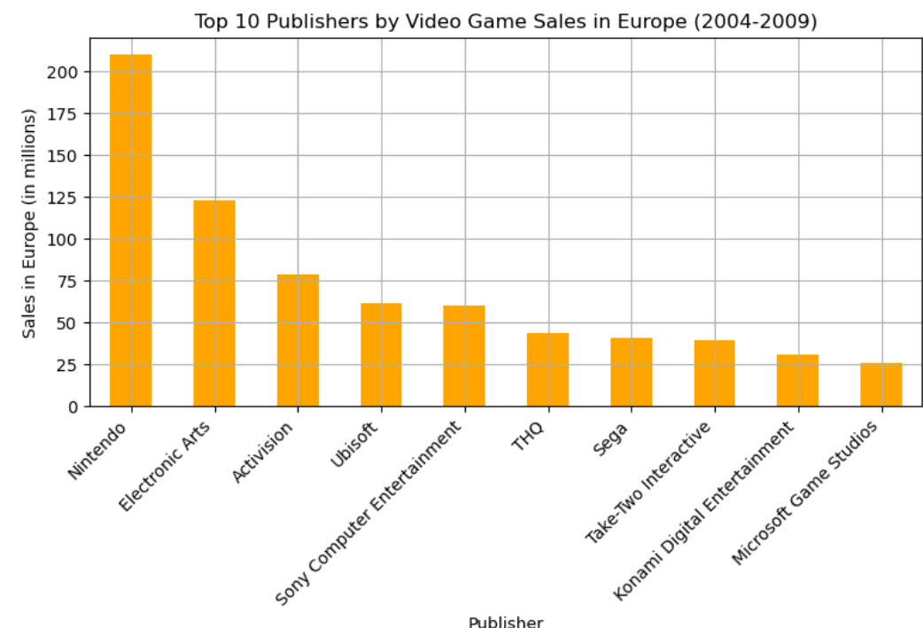
Top 10 Publishers by Video Game Sales in Europe (2004-2009)
Nintendo Leads: First in chart with 200M sales.
Electronic Arts: Follows closely with 150M sales.
Activision: Third place with 100M sales.
Mid-Tier: Ubisoft and Sony Computer Entertainment both around 75M sales.
Lower Tier: THQ, Sega, and others range between 50M to 25M sales.

Slide 13
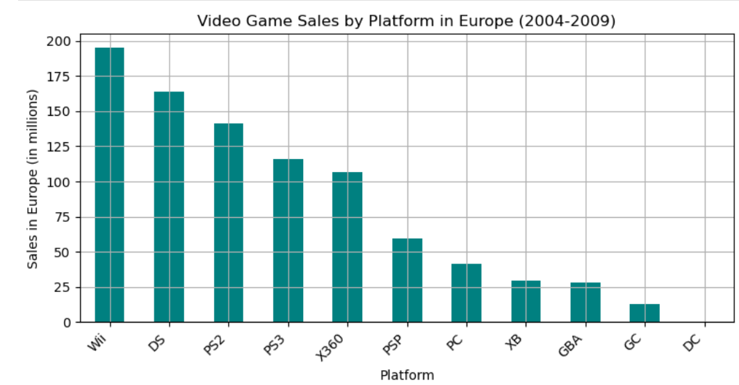
Video Game Sales by Platform in Europe (2004-2009)
Wii Dominates: Leads with 175M sales
DS and PS2: Close behind with 150M each.
PS3 and X360: Both platforms around 125M sales.
Mid-Tier: PSP (75M) and PC (60M) follow
Lower Sales: XB, GBA, GC, and DC range between 25M to 50M sales.

Slide 14
Findings
Popular genres like Action, Sports, and Shooter games attracted many players.
Major publishers, including Nintendo and EA, led the market with successful games.
Platforms such as the Wii, PlayStation 2, and Xbox 360 gained widespread popularity due to their innovative features and diverse game libraries.
These factors combined to fuel a significant rise in video game sales in Europe from 2004 to 2009.

Slide 15
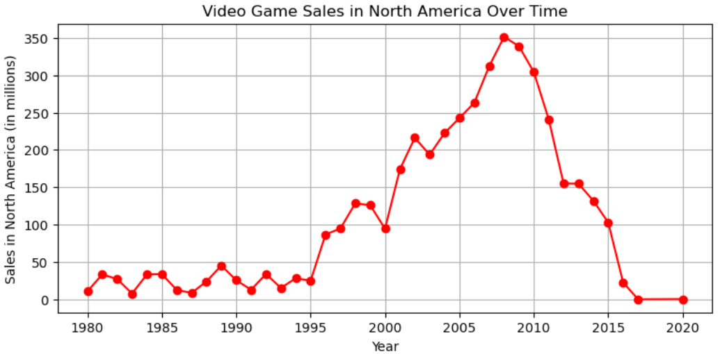
Q3. ROOT CAUSE OF N.AMERICA DROP
Video Game Sale in North America Over Time
Early Stability (1980-2000): Sales in North America were relatively stable, staying below 50 million until 2000
Sharp Increase (2000-2010): Sales surged, peaking at around 325 million in 2010
Sharp Increase (2000-2010): Sales surged, peaking at around 325 million in 2010
Peak Sales: The highest sales point was approximately 325 million in 2010
Recent Low: Sales have returned to levels similar to those seen before 2000, around 50 million

Slide 16
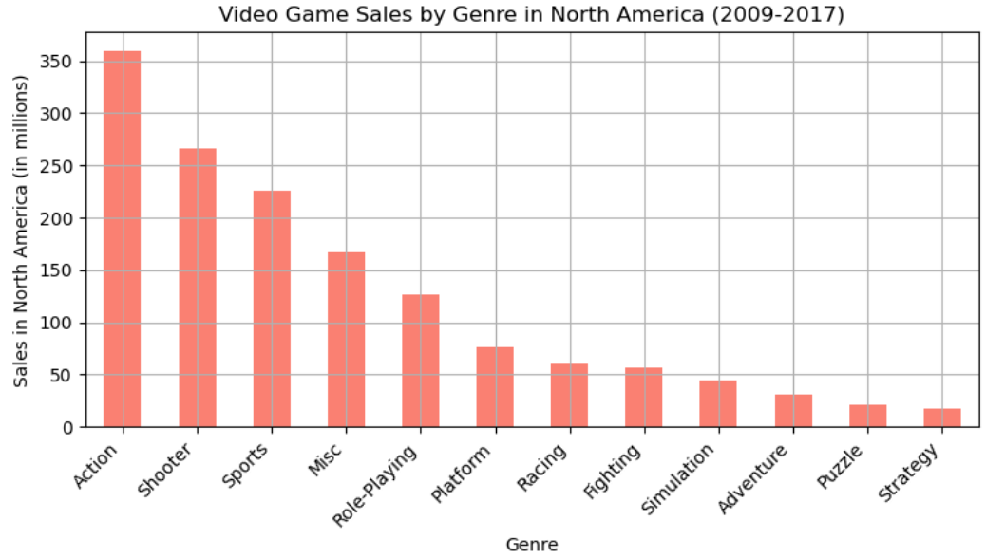
Video Game Sales by Genre in North America (2009-2017)
Action Games Lead: Action is the top genre with around 350 million sales.
Popular Genres: Shooters and Sports games are also big, with about 300 million and 250 million sales respectively.
Moderate Sellers: Miscellaneous, Role-Playing, and Platform games range between 125 to 200 million in sales.
Smaller Genres: Racing, Fighting, and Simulation games each have around 100 million in sales
Least Popular: Adventure, Puzzle, and Strategy games have the lowest sales, all under 50 million

Slide 17
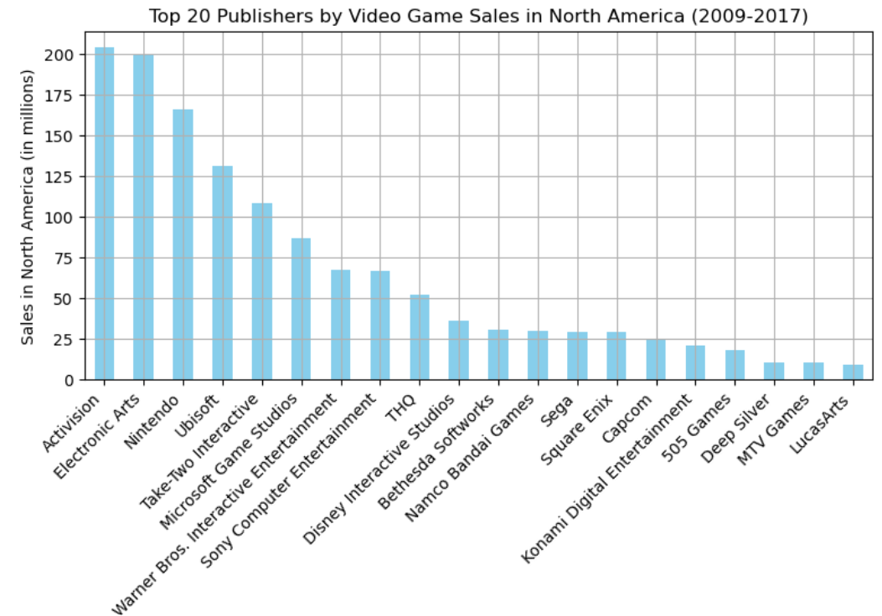
Top 20 Publishers by Video Game Sales in North America (2009-2017)
Activision Leads: Tops the list with around 200 million in sales.
Close Behind: Electronic Arts and Nintendo are close, each with about 180 million
Strong Mid-Tier: Ubisoft, Take-Two, and Microsoft Game Studios have over 100 million in sales
Lower Tier: Publishers like Warner Bros. and Disney range from 75 to 100 million
Smallest: LucasArts and MTV Games round out the list with around 25 million in sales.

Slide 18
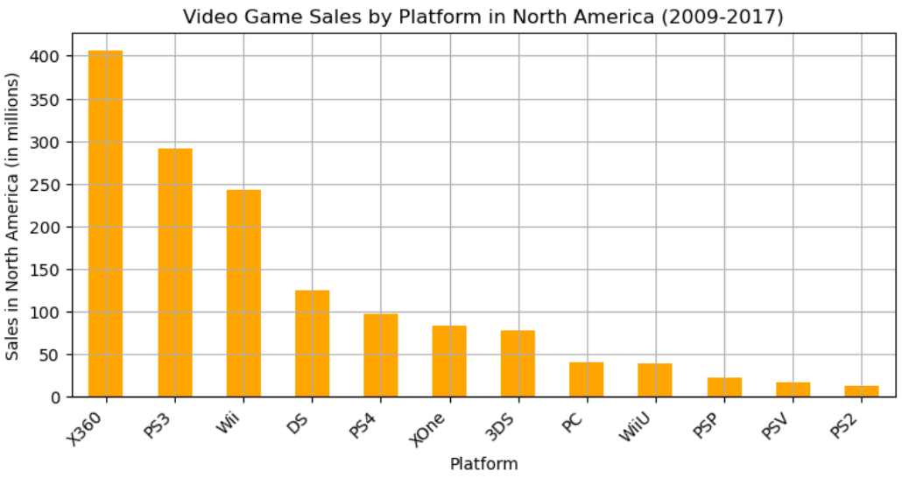
Video Game Sales by Platform in North America (2009-2017)
X360 Dominates: Leads with around 400 million in sales.
PS3 and Wii: Close contenders, with PS3 at about 350 million and Wii at 250 million.
Mid-Tier Platforms: DS and PS4 each have around 200 million in sales.
Lower Sales: XOne, 3DS, and PC hover between 100 and 150 million.
Least Popular: PS2, PS Vita, and PSP have the lowest sales, below 50 million

Slide 19
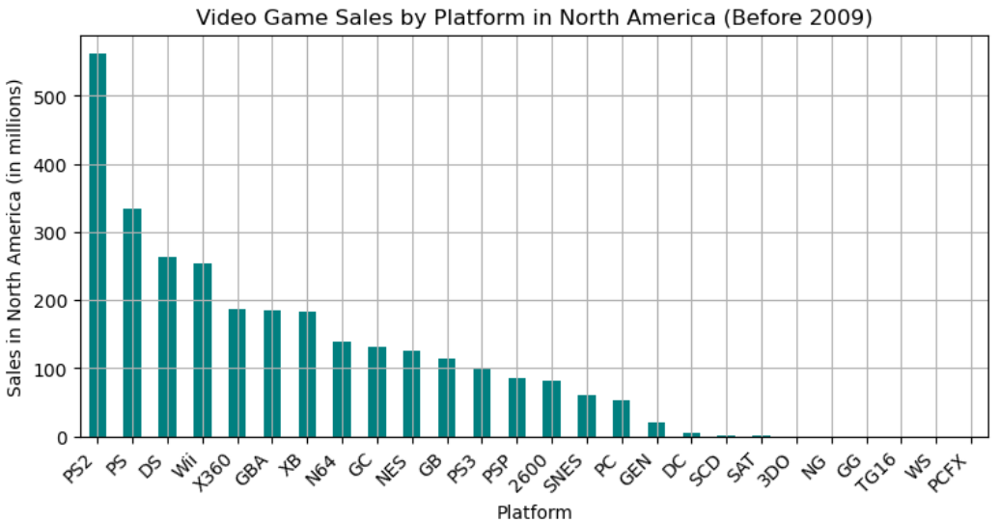
Video Game Sales by Platform in North America (Before 2009)
PS2 Leads: Dominates with over 500 million in sales.
PS and DS: Strong performers, each with around 400 million.
Mid-Tier: Wii, X360, and GBA range between 200 and 300 million.
Lower Sales: Platforms like N64, Xbox, and NES have between 100 and 200 million.
Least Popular: Older systems like 3DO, SAT, and others have very low sales, under 50 million.

Slide 20
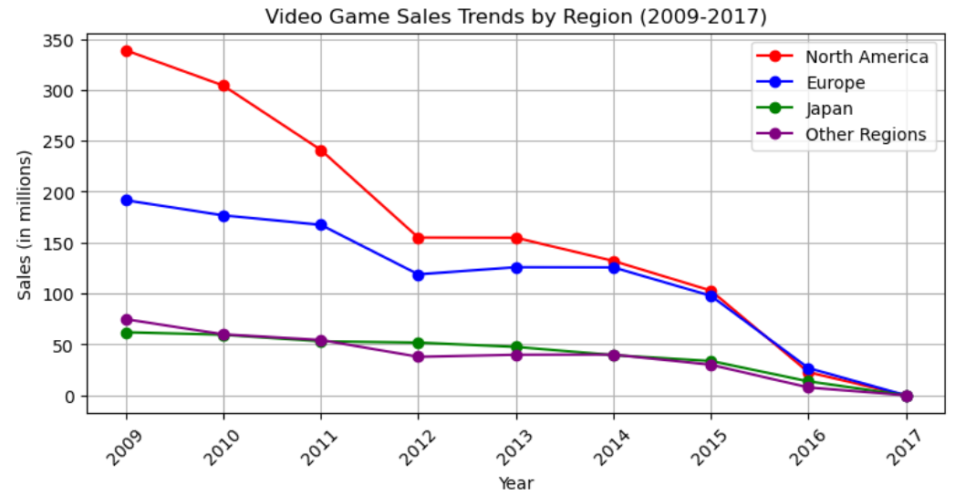
Video Game Sales Trends by Region (2009-2017)
North America Decline: Sales dropped sharply from 350M in 2009 to nearly 50M in 2017.
Europe Follows: Sales decreased steadily from 200M in 2009 to about 100M in 2017.
Japan & Other Regions: Both started below 50M in 2009 and declined to almost zero by 2017.
Overall Trend: All regions experienced a significant drop in sales over the period.

Slide 21
Findings
Genres Lost Popularity: Some video game genres that were once popular saw a decline in interest, which affected overall sales.
Fewer Hit Games: Major publishers didn’t release as many successful games during this period, leading to lower sales.
Aging Platforms: Older consoles like the Wii, PlayStation 2, and Xbox 360 weren’t as popular anymore, and new consoles didn’t fully make up for the drop.
All these factors together caused a steady decline in video game sales in North America from 2009 to 2017.

Slide 22
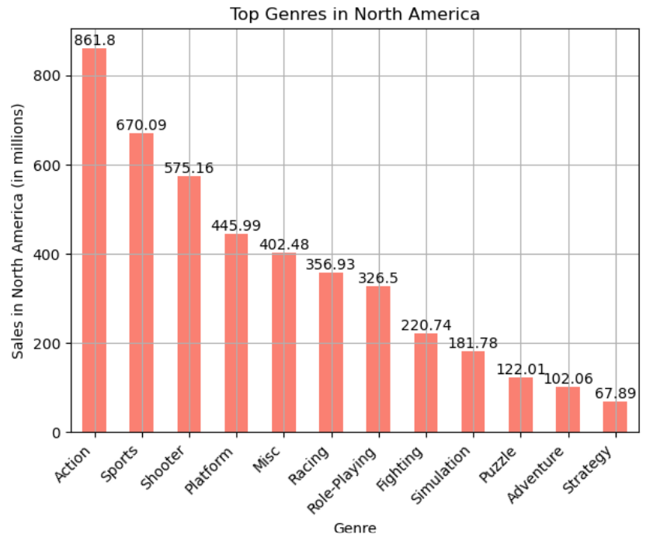
Q4.TOP GENRES PER REGION
1.Top Genres in North America
Action Leads: Tops the chart with 861.8 million sales.
Sports and Shooter: Strong genres with 670.09M and 575.16M sales.
Platform and Misc: Mid-range sales at 445.99M and 402.48M.
Lower Sales: Strategy and Adventure are the least popular, with 67.89M and 102.06M sales.

Slide 23
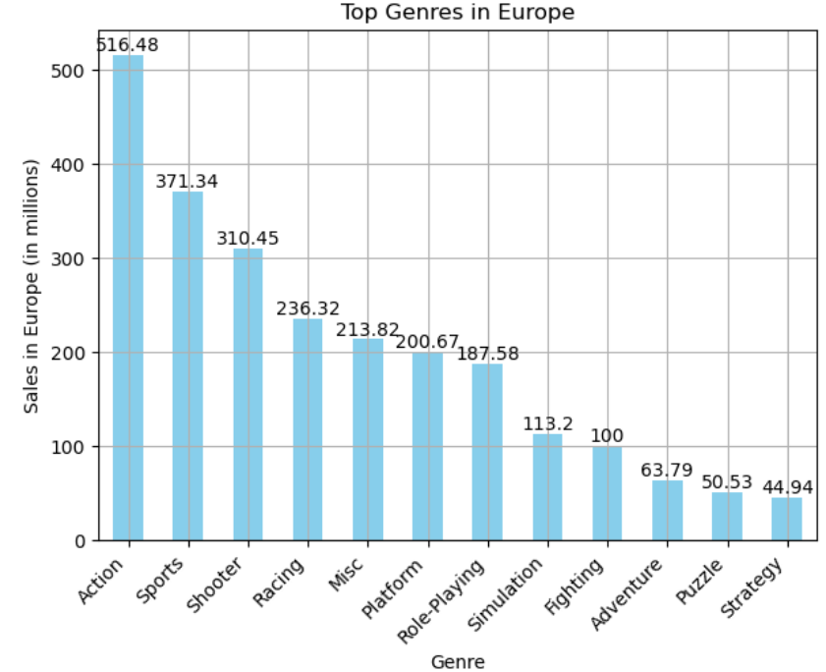
2.Top genres in Europe
Action Leads: Most popular with 516.48 million sales.
Sports and Shooter: Strong performers with 371.34M and 310.45M sales.
Racing and Misc: Mid-range sales, around 236.32M and 213.82M.
Lower Sales: Adventure, Puzzle, and Strategy have the lowest sales, between 44.94M and 100M.

Slide 24
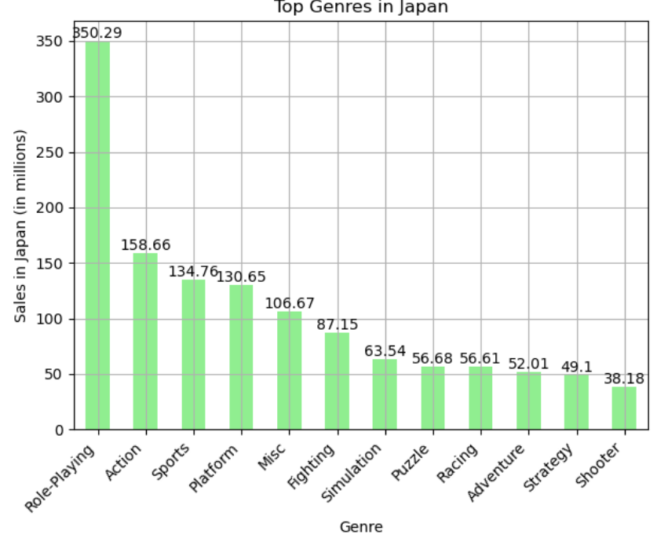
3.Top genres in Japan
Action Leads: Most popular with 516.48 million sales.
Sports and Shooter: Strong performers with 371.34M and 310.45M sales.
Racing and Misc: Mid-range sales, around 236.32M and 213.82M.
Lower Sales: Adventure, Puzzle, and Strategy have the lowest sales, between 44.94M and 100M.

Slide 25
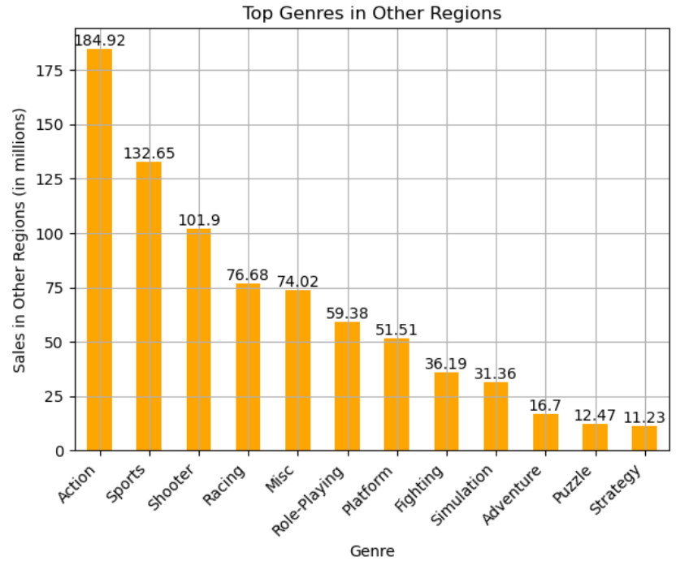
4.Top genres in Other Regions
Action Leads: The top genre with 184.92 million sales.
Sports and Shooter: Popular genres with 132.65M and 101.9M sales.
Racing and Misc: Mid-tier with 76.68M and 74.02M sales.
Lower Sales: Puzzle and Strategy are the least popular, with 16.7M and 11.23M sales.

Slide 26
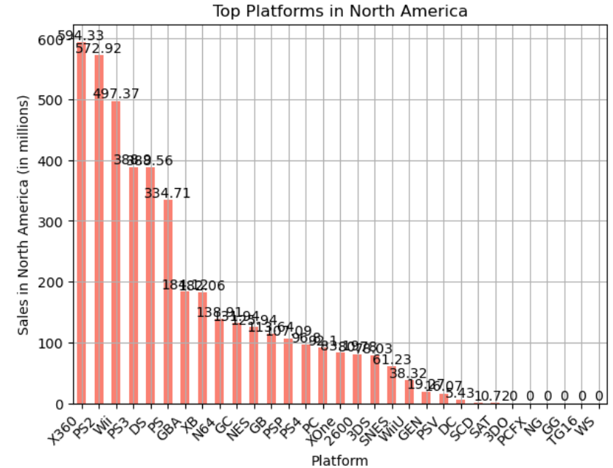
Q5. TOP PLATFORMS PER REGION
1.Top Platforms in North America
X360 and PS2: Top platforms with 600M and 570M sales.
Wii and PS3: Strong, around 500M and 390M sales.
Mid-Tier: DS and GBA at 300-400M.
Lower Sales: SNES, GEN, PS Vita range 20-60M.
Minimal Sales: 3DO, PCFX, TG16 with negligible sales.

Slide 27
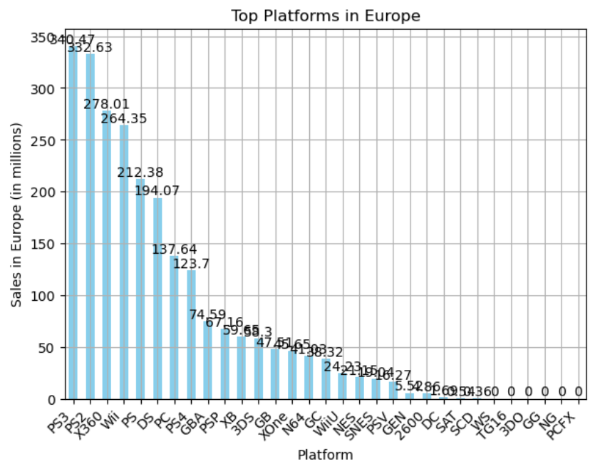
2.Top platforms in Europe
PS3 and PS2 Lead: Top platforms with 350.47M and 332.63M sales.
X360 and Wii: Strong performers, around 278M and 264M.
Mid-Tier: PS4 and DS with 200-250M sales.
Lower Sales: Platforms like SNES, GEN, and PSV range from 20-50M.
Minimal Sales: Older systems like 3DO, PCFX, and TG16 have negligible sales.

Slide 28
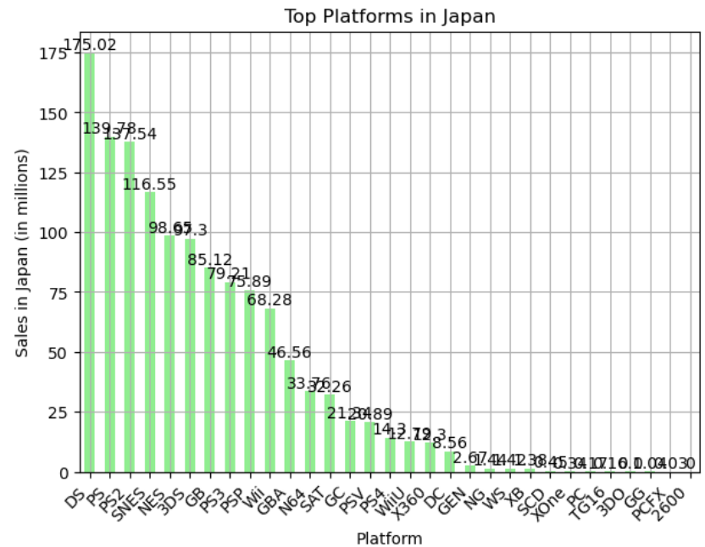
3.Top platforms in Japan
DS and PS2 Lead: DS tops with 175.02M, followed by PS2 at 139.75M.
SNES and NES: Strong platforms with 116.55M and 98.91M sales.
Mid-Tier: 3DS, GB, and PS3 range from 85M to 79M sales.
Lower Sales: Platforms like GBA, Wii, and GC range from 33M to 68M.
Minimal Sales: Older systems like 2600, PCFX, and TG16 have negligible sales.

Slide 29
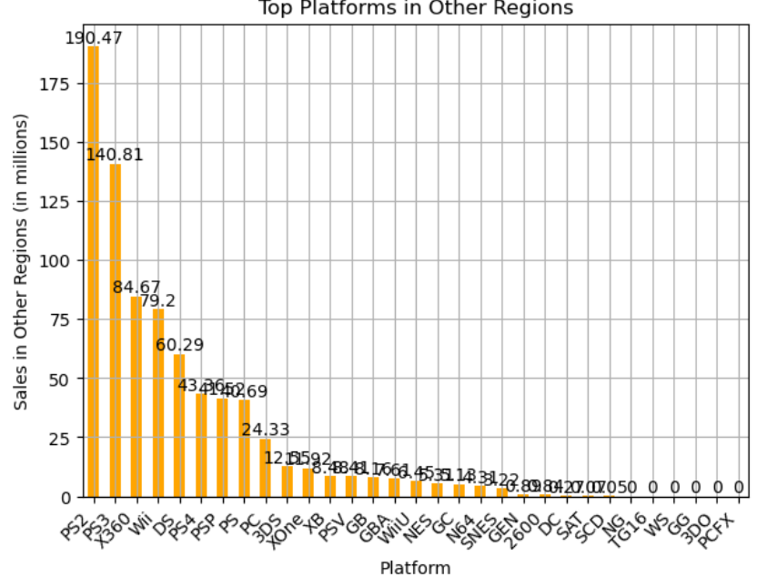
4.Top platforms in Other Regions
PS2 Leads: Tops with 190.47M sales.
PS3 and X360: Strong performers with 140.81M and 84.67M.
Mid-Tier: Wii and DS have sales around 79.2M and 60.29M.
Lower Sales: Platforms like PS4, PSP, and PS have sales between 24M and 43M.
Minimal Sales: Older or niche platforms like 3DO, TG16, and PCFX have negligible sales.

Slide 30
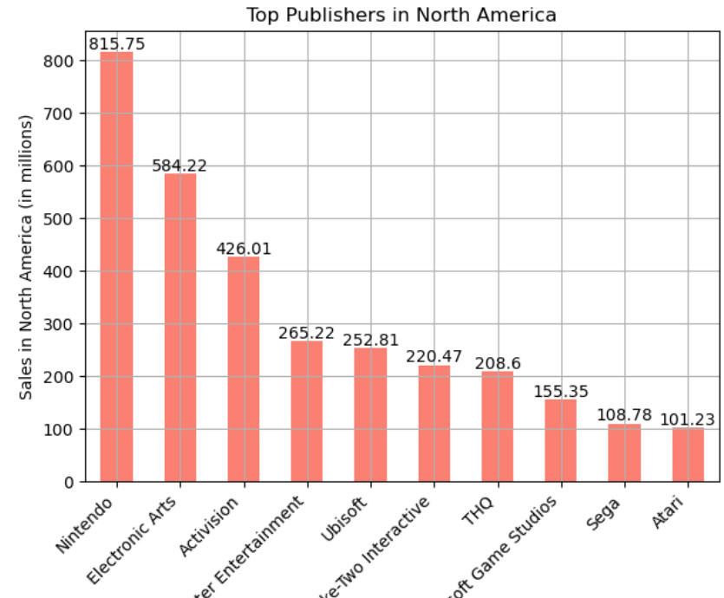
Q6. TOP PUBLISHERS PER REGION
1.Top Publishers in North America
Nintendo Leads: Dominates with 815.75M sales.
Electronic Arts and Activision: Strong performers with 584.22M and 426.01M.
Mid-Tier: Sony Computer Entertainment and Ubisoft around 250-265M.
Lower Sales: THQ, Microsoft Game Studios, and Sega range from 155M to 220M.
Smallest: Atari rounds out the list with 101.23M sales.

Slide 31
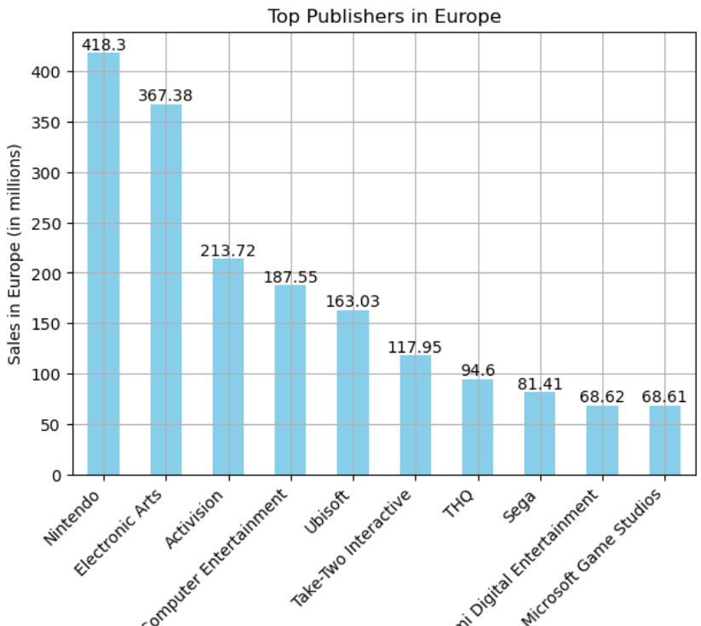
2.Top publishers in Europe
Nintendo Leads: Tops with 418.3M sales.
Electronic Arts and Activision: Strong performers with 367.38M and 213.72M.
Mid-Tier: Sony Computer Entertainment and Ubisoft with 187.55M and 163.03M.
Lower Sales: THQ, Sega, and Konami range from 81M to 118M.
Smallest: Microsoft Game Studios at 68.61M sales.

Slide 32
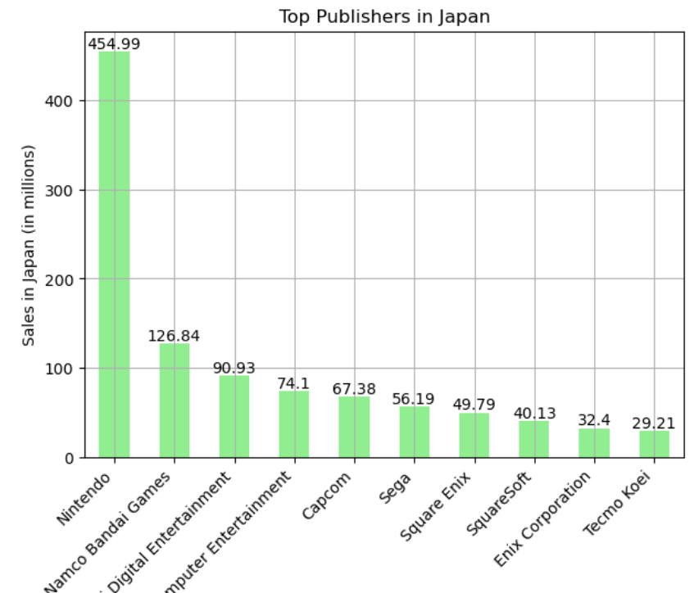
3.Top publishers in Japan
Nintendo Leads: Dominates with 454.99M sales.
Namco Bandai: Strong second with 126.84M sales.
Mid-Tier: Capcom and Sega range from 67M to 74M.
Lower Sales: Square Enix, SquareSoft, and Enix Corporation have sales between 40M and 56M.
Smallest: Tecmo Koei rounds out the list with 29.21M sales.

Slide 33
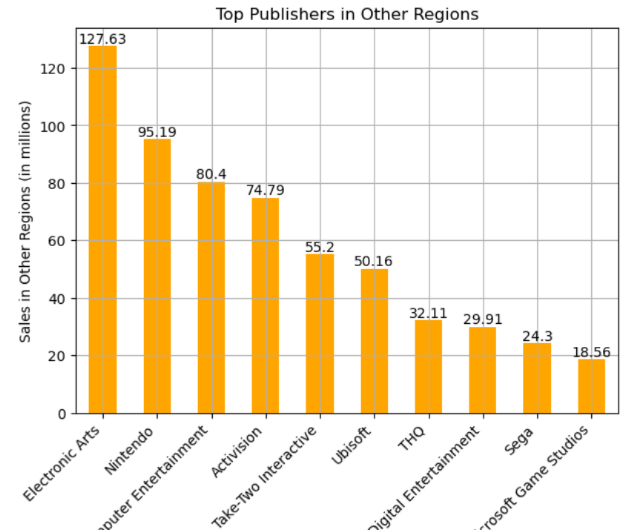
4.Top publishers in Other Regions
Electronic Arts: Leads with 127.63M sales.
Nintendo: Follows with 95.19M sales.
Sony Computer Entertainment: Strong at 80.4M sales.
Mid-Tier: Activision and Take-Two Interactive with 74.79M and 55.2M.
Lower Sales: Sega and Microsoft Game Studios at 24.3M and 18.56M.

Slide 34
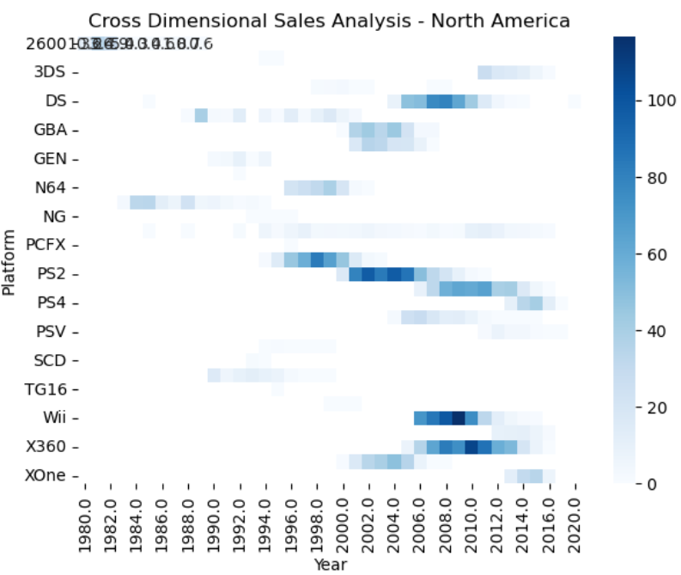
CROSS DIMENSIONAL MARKETING SALES LEAD
1.Cross Dimensional Sales Analysis –North America
Top Platforms: PS2 and X360 lead sales, especially from 2005-2010
Consistent Performance: PS2 shows steady sales over several years.
Emerging Platforms: Wii and PS4 rise in later years.
Low Sales: 2600 and PCFX have minimal sales.
Decline: N64 and GBA peak early, then drop off.

Slide 35
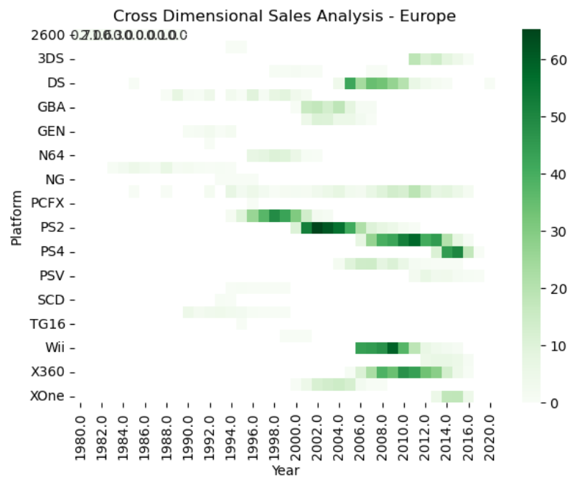
2. Cross Dimensional Sales Analysis - Europe
Top Platform: PS2 leads in sales.
Consistent Sales: PS2 and PS4 sustain performance.
Emerging Trend: DS gains traction post-2004.
Niche Market: PCFX and NG have limited success.
Decline: Older platforms like SCD and TG16 phase out early.

Slide 36
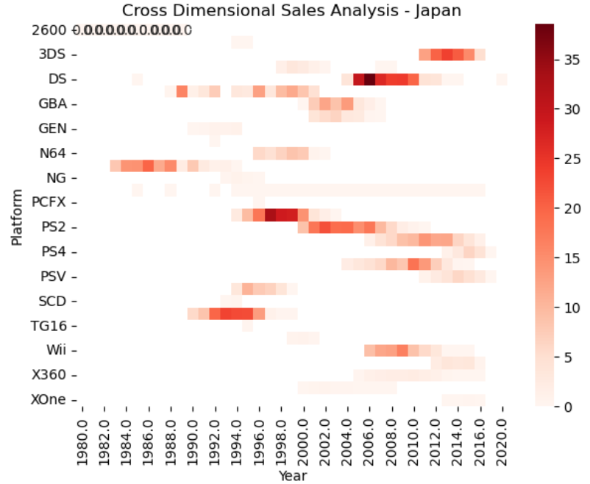
3. Cross Dimensional Sales Analysis - Japan
Top Platform: PS2 leads in sales.
Consistent Sales: PS2 and PS4 show sustained performance.
Emerging Trend: DS gains traction post-2004.
Niche Market: Platforms like PCFX and NG have limited success.
Decline: Older platforms like SCD and TG16 phase out early.

Slide 37
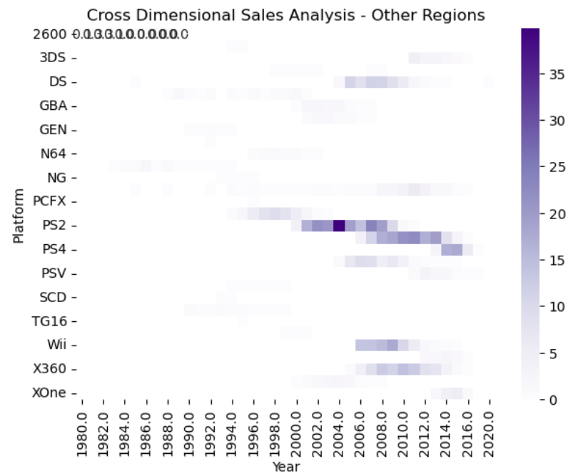
4.Cross Dimensional Sales Analysis - Other Regions
Top Platform: PS2 dominates in sales.
Emerging Trends: PS4 and X360 start gaining traction.
Limited Success: Older platforms like PCFX see minimal sales.
New Arrivals: PSV and XOne enter the market in later years.
Decline: Platforms like SCD fade out early.

Slide 38
Approaches to Boost Sales Across Different Regions
1. Tailor Games to Regional Preferences:
North America: Focus on making more Action and Sports games.
Europe: Expand in Action, Sports, and Shooter genres.
Japan: Invest in Role-Playing games or localize popular RPGs.
Other Regions: Concentrate on Action and Sports games that resonate well.
2. Support Key Platforms:
Keep developing for successful platforms like PS2, PS3, and X360 with remastered versions and new content.
Explore and invest in new platforms in regions with lower sales to reach untapped audiences.

Slide 39
Approaches to Boost Sales Across Different Regions
3. Adapt to Local Cultures:
Ensure games are localized properly and reflect local cultures.
Consider offering exclusive content or special editions tailored to regional tastes.
4. Boost Marketing and Partnerships:
Ramp up marketing in regions where certain genres are popular.
Collaborate with local influencers or companies to connect better with the audience.

Slide 40
Approaches to Boost Sales Across Different Regions
5. Try Out New Genres:
Experiment with niche genres through strong marketing campaigns to discover new opportunities.
Look for growth potential in genres that are currently underrepresented.
6. Expand Popular Franchises:
Take well-known franchises and expand them into new genres or platforms.
7. Use Data to Drive Decisions:
Analyze sales data to spot trends and gaps in the market.
Invest in areas that show potential for growth

